Slide 1
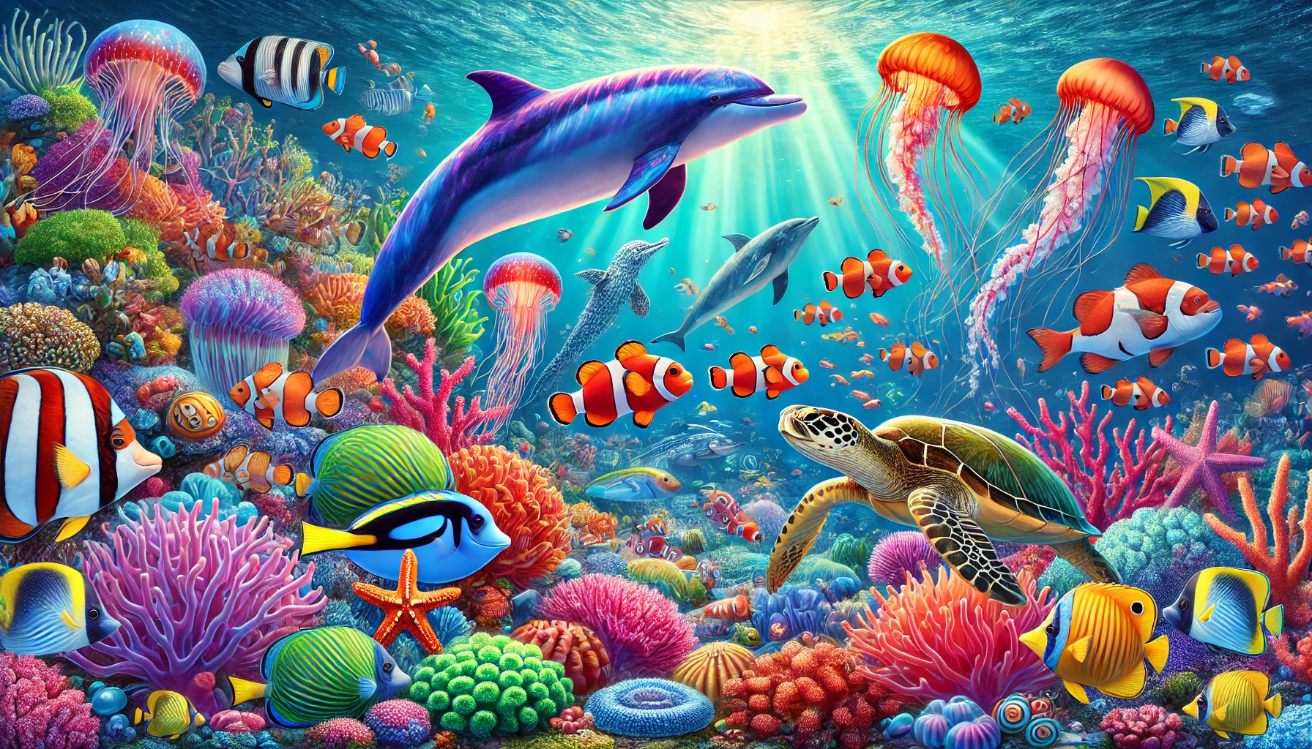
Little Diver Artists
Coloring Book

Slide 2


Trace & Color
Sea Animals
Crab

Slide 3


Trace & Color
Sea Animals
Lobster

Slide 4



Trace & Color
Sea Animals
Shrimp

Slide 5


Trace & Color
Sea Animals
Octopus

Slide 6


Trace & Color
Sea Animals
Whale

Slide 7


Trace & Color
Sea Animals
Shark

Slide 8


Trace & Color
Sea Animals
Dolphin

Slide 9


Trace & Color
Sea Animals
Jellyfish

Slide 10


Trace & Color
Sea Animals
Starfish

Slide 11


Trace & Color
Sea Animals
Stingray

Slide 12

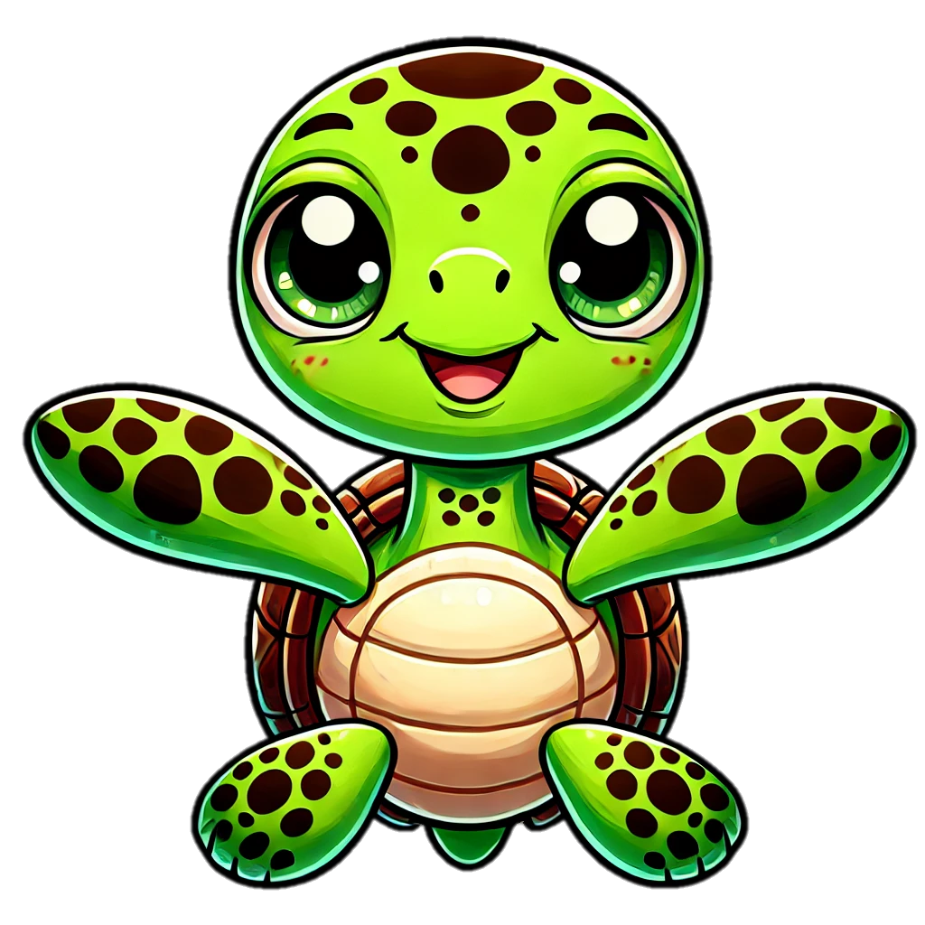
Trace & Color
Sea Animals
Turtle

Slide 13


Trace & Color
Sea Animals
Seahorse

Slide 14


Trace & Color
Sea Animals
Walrus

Slide 15


Trace & Color
Sea Animals
Seal

Slide 16


Trace & Color
Sea Animals
Manatee

Slide 17


Trace & Color
Sea Animals
Otter

